Slide 1
GENETIC INHERITANCE

Slide 2
Lesson Objectives
At the end of this lesson you should be able to
Give a definition for a gamete
Understand gamete formation
Give the function of gamete in sexual reproduction
Define fertilisation
Define allele
Differentiate between the terms homozygous and heterozygous

Slide 3
Lesson Objectives (cont.)
At the end of this lesson you should be able to
Differentiate between genotype and phenotype
Differentiate between dominant and recessive
Show the inheritance to the F₁ generation in a cross involving:
Homozygous parents
Heterozygous parents
Sex determination
Show the genotypes of parents, gametes and offspring

Slide 4
Sexual Reproduction
Involves two parents
Each parent makes reproductive cells
- called gametes

Slide 5

Def: Heredity-the passing on of features from one generation to the next
Def: FertilisationThe fusion of male and female gametes to form a diploid zygote
Def: Gametes- haploid cells capable of fusion

Slide 6
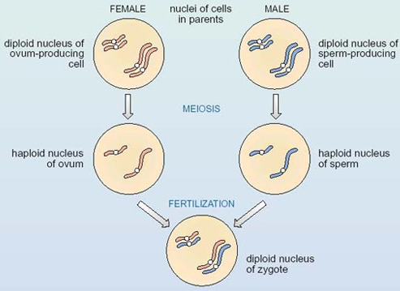

Slide 7
What are Gametes?
Reproductive Cells
Formed by meiosis
Contain single sets of chromosomes
- haploid
Capable of fusion to form zygote
- diploid
Zygote contains genetic information of both gametes

Slide 8
Learning Check
What are reproductive cells called?
Where are they found?
Are they haploid or diploid cells?
How are they formed?
What is a zygote?

Slide 9
Sex Chromosomes
We have 46 chromosomes, or 23 pairs.
Autosomes are non sex chromosomes- We have 44
Autosomes (no 1 –22)
The other 2 chromosomes are the sex chromosomes: the X chromosome and the Y chromosome.
Males -XY;
females have XX
All embryos start life as female

Slide 10
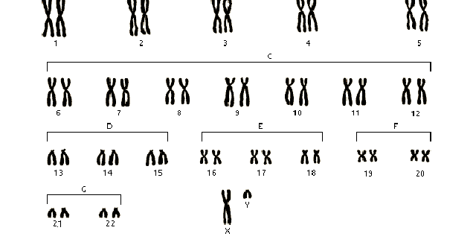
Male Karyotype

Slide 11
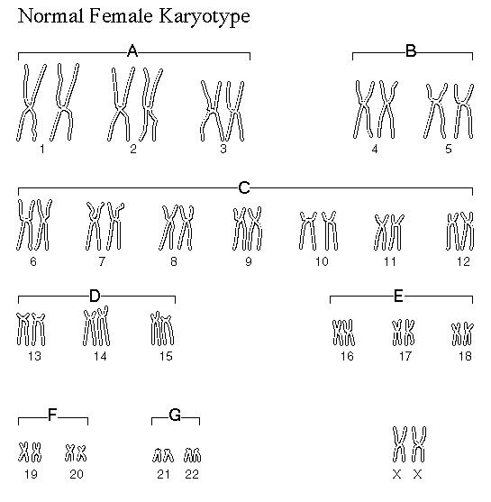
Female Karyotype

Slide 12
Sex Determination
The basic rule:
If the Y chromosome is present, the person is male.
If absent, the person is female.

Slide 13
Meiosis
the X and Y chromosomes separate and go into different sperm cells:
½ the sperm carry the X and the other half carry the Y.
All eggs have one of the mother’s X chromosomes
The Y chromosome has the main sex-determining gene on it, called SRY

Slide 14
Sex Determination
About 4 weeks after fertilization, an embryo that contains the SRY gene develops testes, the primary male sex organ.
The testes secrete the hormone testosterone.
Testosterone signals the other cells of the embryo to develop in the male pattern.

Slide 15
Learning Check
How many pairs of chromosomes does a human somatic cell have?
Which pair of chromosomes determines the sex of the offspring?
If you are male what does chromosome pair number 23 look like?
If you are female what does chromosome pair number 23 look like?

Slide 16
Def Genetics -The study of heredity.
Gregor Mendel (1860’s) discovered the fundamental principles of genetics by breeding garden peas.

Slide 17
Genetic Terms
Alleles- Alternative forms of genes.
Dominant alleles (TT - tall pea plants)
Dominant-allele that is always expressed if present

Slide 18
Recessive alleles (tt - dwarf pea plants)
Recessive-the allele that is prevented from being expressed by dominant allele

Slide 19
Phenotype
Outward appearance
Physical characteristics
Examples:
1. tall pea plant
2. dwarf pea plant

Slide 20
Genotype
The genetic make up of the organism
Example:
1. tall pea plant
TT = tall (homozygous dominant)
2. dwarf pea plant
tt = dwarf (homozygous recessive)
3. tall pea plant
Tt = tall (heterozygous)

Slide 21
Homozygous-Two alleles that are identical ex. TT
Heterozygous- Two alleles that are different ex. Tt

Slide 22
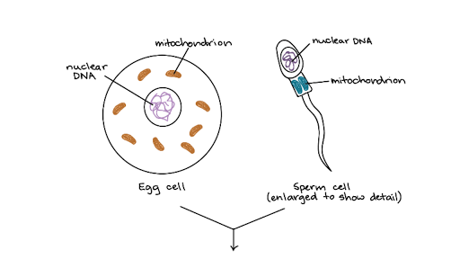
Non-nuclear DNA- DNA which is found in mitochondria and chloroplast which can also be inherited via the egg (ovum)
Most DNA is found in chromosomes in the nucleus

Slide 23
Punnett square
A Punnett square is used to show the possible combinations of gametes.

Slide 24
Learning Check
What is genetics?
What is an allele?
What is the difference between phenotype and genotype?
What is a punnett square used for?

Slide 25
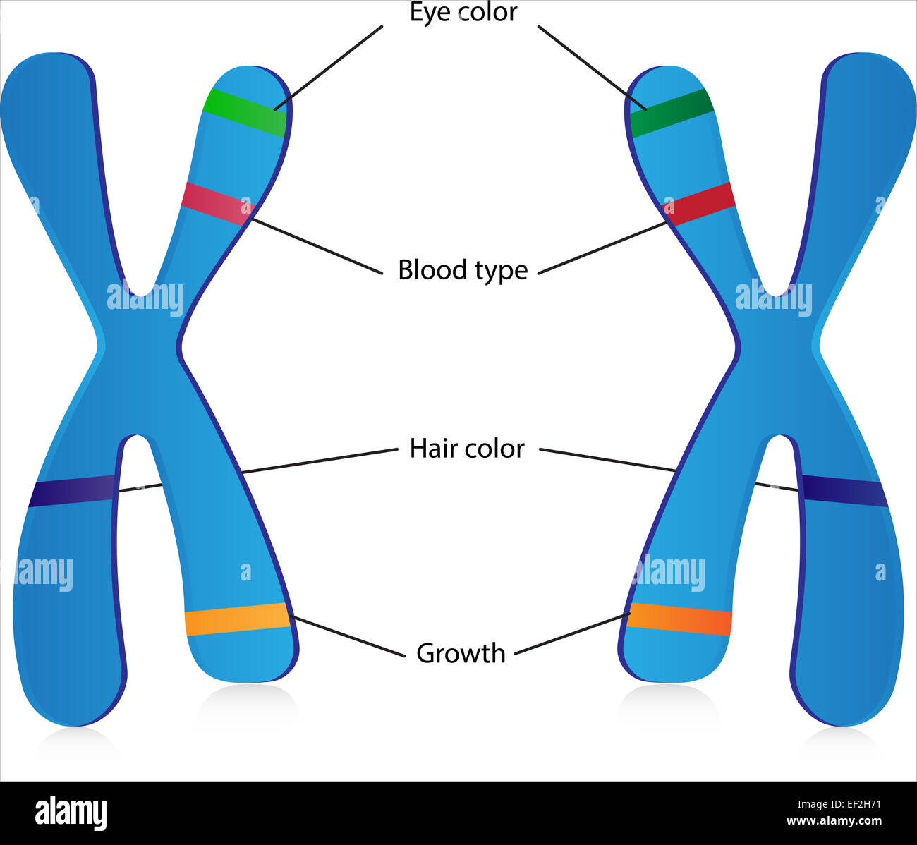

Slide 26
Breed the P generation
tall (TT) vs. dwarf (tt) pea plants
T
T
t
t

Slide 27
tall (TT) vs. dwarf (tt) pea plants
T
T
Tt
produces the
F₁ generation
t
Tt
t
Tt
Tt
All Tt = tall
(heterozygous tall)

Slide 28
Breed the F₁ generation
tall (Tt) vs. tall (Tt) pea plants
T
t
T
t

Slide 29
tall (Tt) vs. tall (Tt) pea plants
T
t
produces the
F₂ generation
T
TT
Tt
1/4 (25%) = TT
1/2 (50%) = Tt
1/4 (25%) = tt
t
Tt
tt
1:2:1 genotype
3:1 phenotype

Slide 30
Monohybrid Cross
A breeding experiment that tracks the inheritance of a single trait.
Mendel’s LAW of segregation 1st law
a. pairs of genes separate during gamete formation (meiosis).
b. the fusion of gametes at fertilization pairs genes once again.

Slide 31
Homologous Chromosomes
eye color locus
B = brown eyes
eye color locus
b = blue eyes
This person would have brown eyes (Bb)
Paternal
Maternal

Slide 32
Mendels Law of Independent Assortment 2nd law
When gametes are formed either of a pair of alleles is equally likely to combine with either of another pair of alleles

Slide 33
Monohybrid Cross
Example: Cross between two heterozygotes for brown eyes (Bb)
BB = brown eyes
Bb = brown eyes
bb = blue eyes
B
b
male
gametes
B
Bb x Bb
b
female gametes

Slide 34
Monohybrid Cross
B
b
1/4 = BB - brown eyed
1/2 = Bb - brown eyed
1/4 = bb - blue eyed
B
BB
Bb
Bb x Bb
b
Bb
bb
1:2:1 genotype
3:1 phenotype

Slide 35
Incomplete Dominance
F1 hybrids have an appearance somewhat in between the phenotypes of the two parental varieties.
Example: snapdragons (flower)
red (RR) x white (rr)
RR = red flower
rr = white flower
R
R
r
r

Slide 36
Examples from Exploring Biology and Biology Plus-On Board

Slide 37
Incomplete Dominance
R
R
produces the
F₁ generation
r
Rr
Rr
r
Rr
Rr
All Rr = pink
(heterozygous pink)

Slide 38
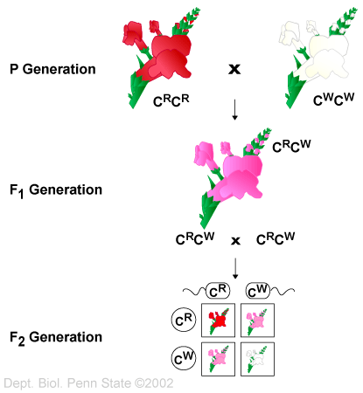
Pink Flowers?

Slide 39
Co-dominance(Interdependance)
Two alleles are expressed (multiple alleles) in heterozygous individuals.
Example: blood
1. type A = I^{A}I^{A} or I^{A}i
2. type B = I^{B}I^{B} or I^{B}i
3. type AB = I^{A}I^{B}
4. type O = ii

Slide 40
Co-dominance
Example: homozygous male B (I^{B}I^{B})
x heterozygous female A (I^{A}i)
I^{B}
I^{B}
I^{A}I^{B}
I^{A}I^{B}
I^{A}
1/2 = I^{A}I^{B}
1/2 = I^{B}i
i
I^{B}i
I^{B}i

Slide 41
Learning Check
What is a monohybrid cross?
What do the terms homozygous and heterozygous represent?
What is the difference between co dominance and incomplete dominance

Slide 42
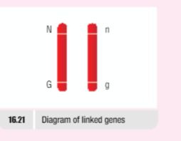
Linked genes-genes that are located on the same chromosomes and are therefore inherited together

Slide 43
DiHybrid Cross –cross involving two characteristics at a time
Example
TB Pg 171

Slide 44
Sex linked Genes-genes found normarily on the X Chromosome
(recessive gene)
Carrier- a female who has an allele for the abnormal condition but does not show it

Slide 45
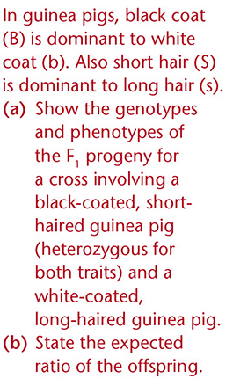

Slide 46
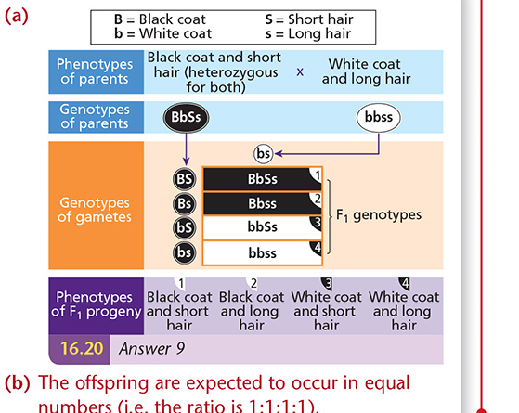

Slide 47
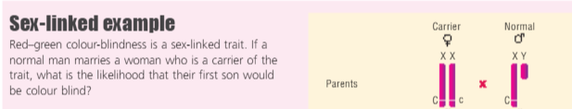

Slide 48
Chromosomes and Genetics
Chromosomes are long pieces of DNA, with supporting proteins
Genes are short regions of this DNA that hold the information needed to build and maintain the body
Genes have fixed locations: each gene is in a particular place on a particular chromosome
Diploids have 2 copies of each chromosome, one from each parent. This means 2 copies of each gene.

Slide 49
What have you learned?
Can you …………………….
Define a gamete and understand gamete formation
Define fertilisation and sex determination
Define allele
Differentiate between the terms homozygous and heterozygous
Differentiate between genotype and phenotype
Differentiate between dominant and recessive
Understand incomplete dominance
Be able to complete monohybrid crosses and state the genotypes and phenotypes of parents and offspring
Understand the 3:1 ratio for heterozygous crosses

Slide 50
Practice with Crosses
http://www.zerobio.com/drag_gr11/mono.htm
http://www.brooklyn.cuny.edu/bc/ahp/MGInv/MGI.Intro.html

Slide 51
End

